Slide 1

Predicting tuition fees of University students

Slide 2
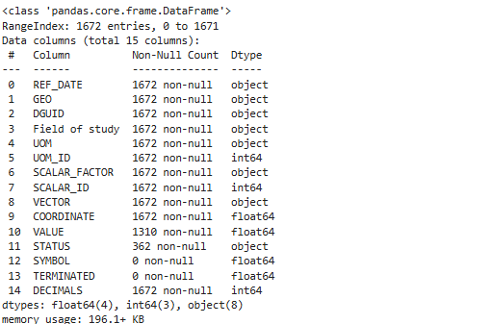
Data cleaning of all 4 csvs
-Columns:
Cleaning:
Drop the columns ‘Symbol’, and ‘terminated
Fill the missing value with the mean based on their Geo and Field
Dropped the rest of the null rows
Added their Level of study: undergrad or grad
Added their nationality: canadian or international
Concating all of them together.

Slide 3
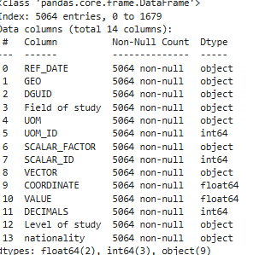

EDA and cleaning of data
EDA:
Check unique values of all the columns
Study the vector and Coordinate columns
Cleaning:
Drop the columns ‘UOM’, UOM_ID, SCALER_FACTOR, SCALER_ID and DECIMALS, because they all had 1 single value.
Dropped also Vector because it had to many unique values
Kept only the last numbers in the dguid since they all thad the same beginning

Slide 4
EDA and cleaning of data
EDA:
Check unique values of all the columns
Study the vector and Coordinate columns
Cleaning:
Drop the columns ‘UOM’, UOM_ID, SCALER_FACTOR, SCALER_ID and DECIMALS, because they all had 1 single value.
Dropped also Vector because it had to many unique values
Kept only the last numbers in the dguid since they all thad the same beginning

Slide 5

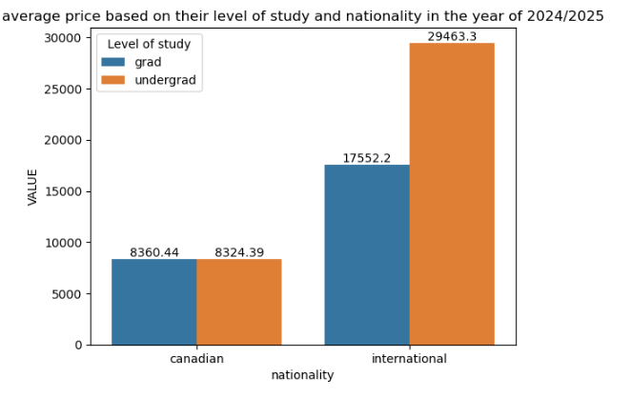
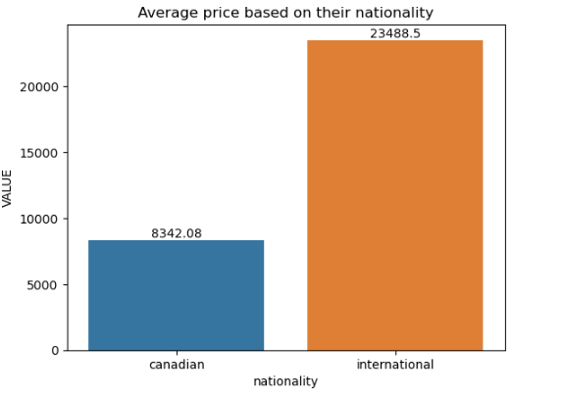
Analysis

Slide 6
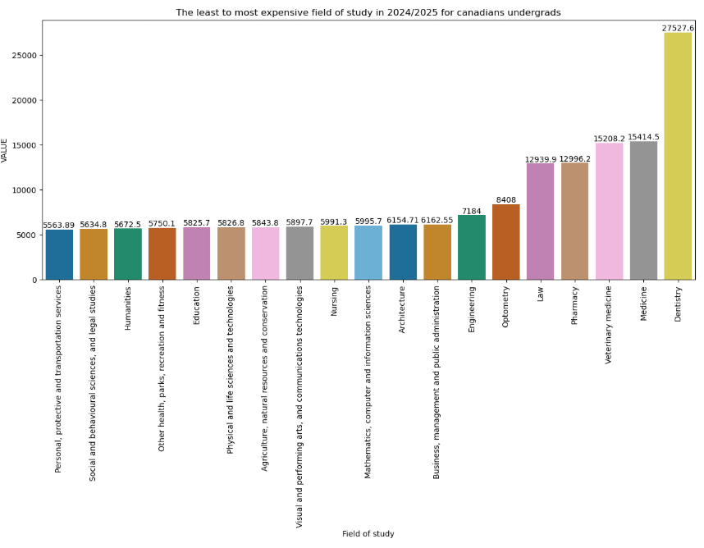
Analysis

Slide 7
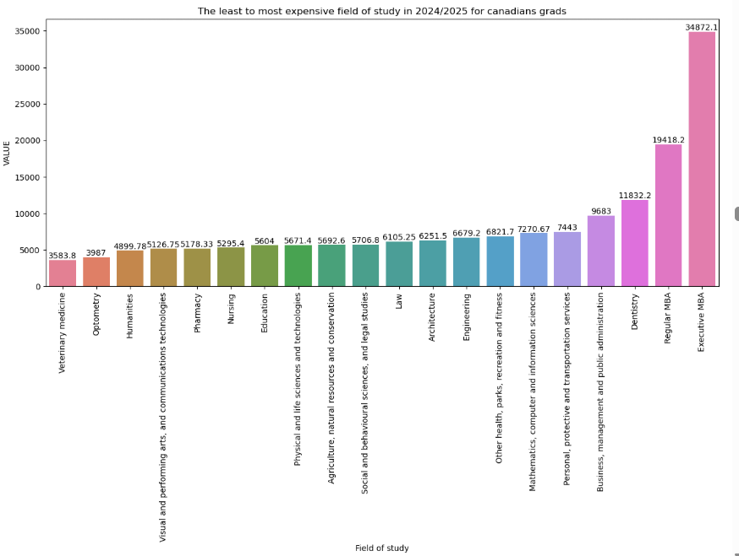
Analysis

Slide 8
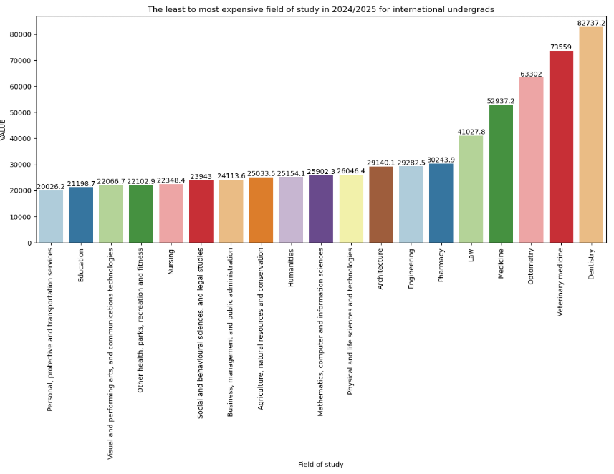
Analysis

Slide 9
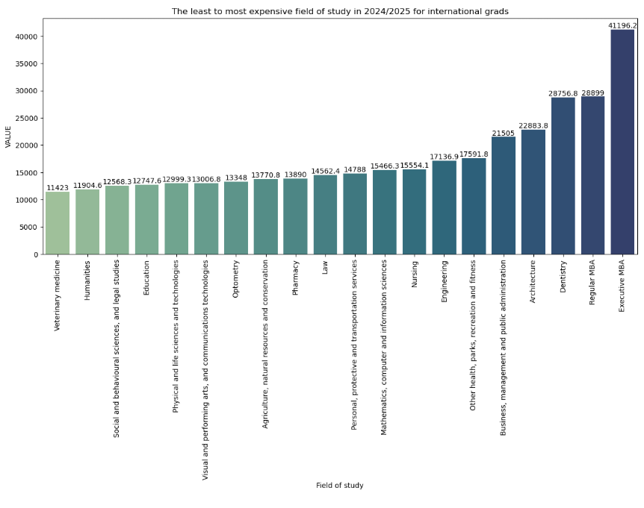
Analysis

Slide 10
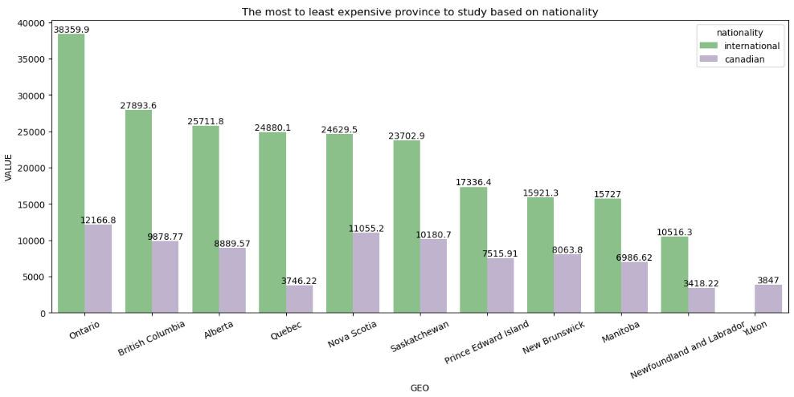
Analysis

Slide 11
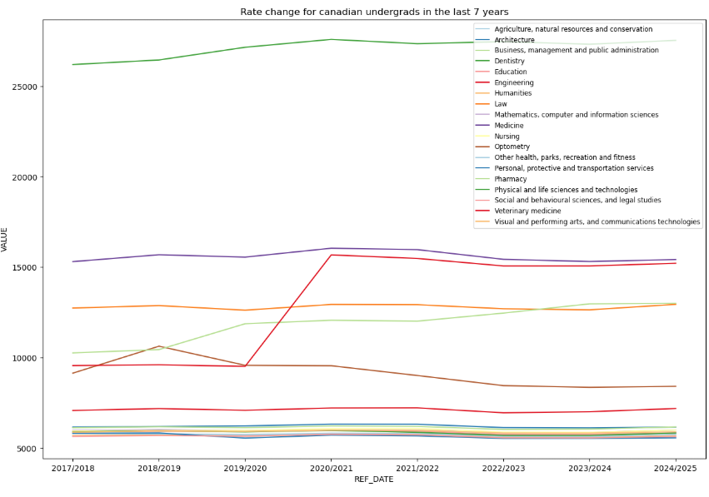
Analysis

Slide 12
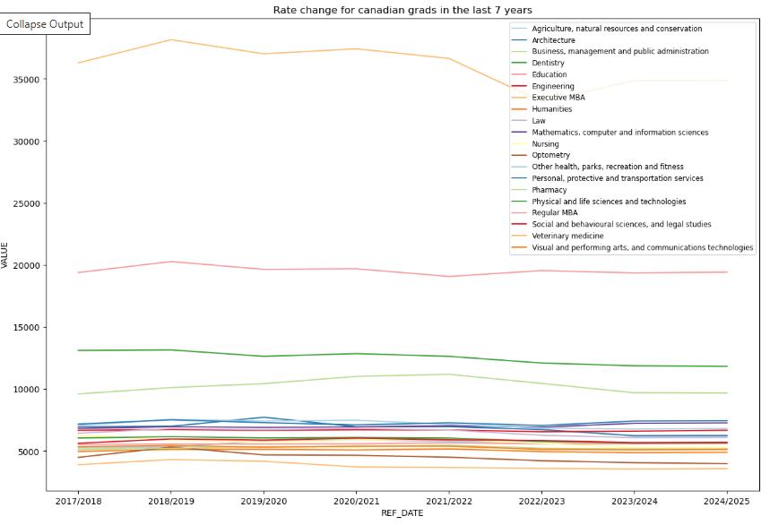
Analysis

Slide 13
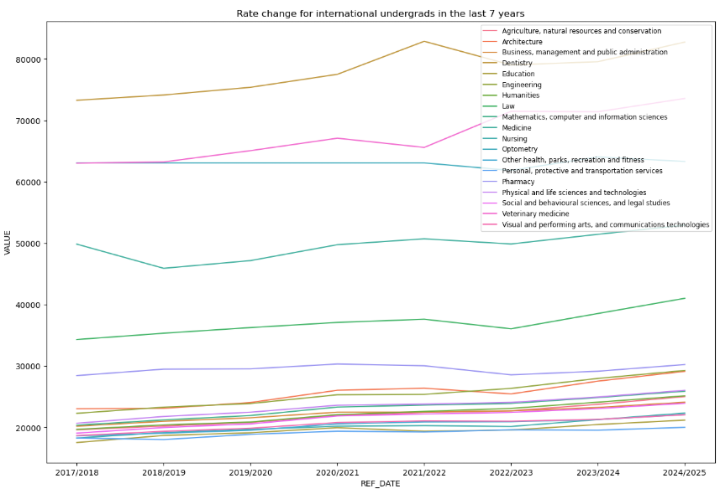
Analysis

Slide 14
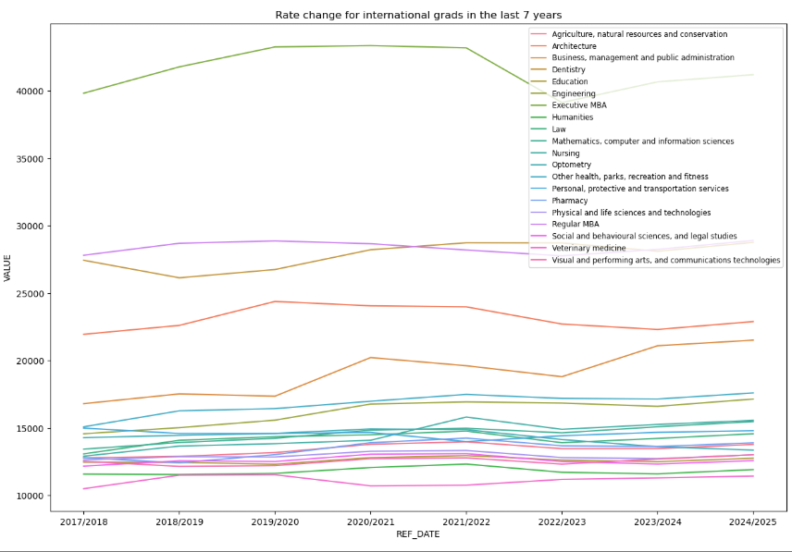
Analysis

Slide 15

Preprocessing steps
-Dropping the columns ‘DGUID’ as model may assume an order which it doesnt
-For columns, 'REF_DATE','Level of study','nationality', i will be using ordinal encoder, as it does have order
For columns,'GEO','Field of study', and field of study, i did one hot encoders
Dropped those columns from original df and joined both of the encoders together.
Scaled the data

Slide 16
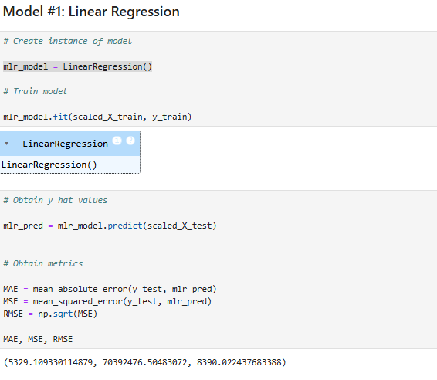
Model 1: Linear Regression

Slide 17
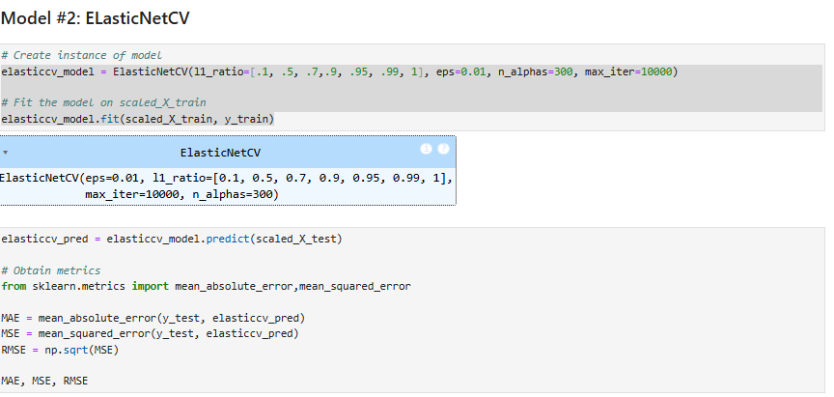
Model 2: ElasticNetCV

Slide 18
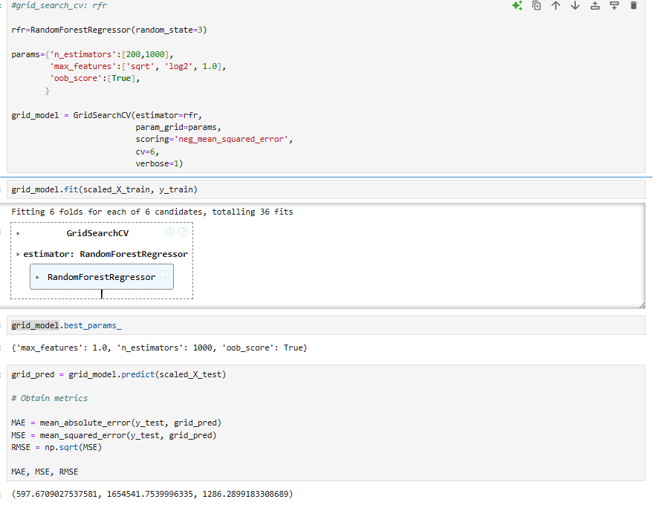
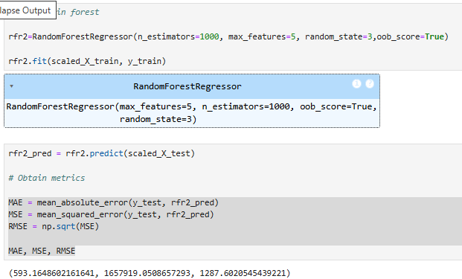
Model 3: RandomForestRegressor
Before fitting the model, to reduce noise, i decided to redo the preprocessing steps, but only Ordinal encoded the columns, and then scaling

Slide 19
‘Coordinate’ model:
I also decided to create a coordinate model, because this column improves the models performance. But the values are dependent with the other columns, and since predict page only has the saved model, not the dataframe, I needed a way to get those values without having to doing df.loc

Slide 20
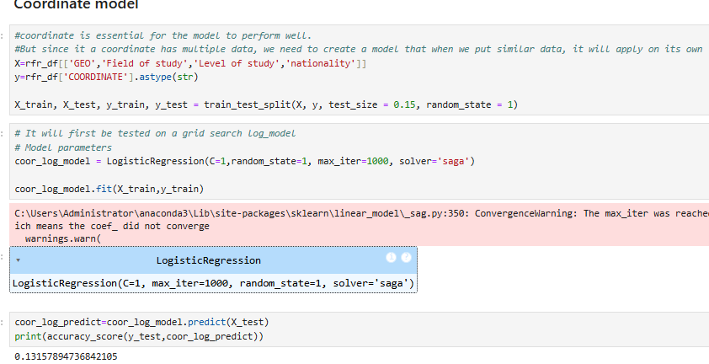
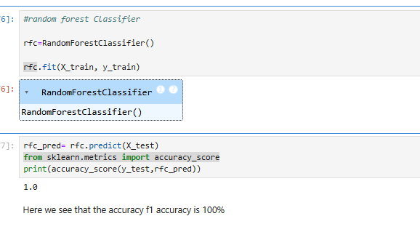
‘Coordinate’ model:
Log_model:
Random Forest Classifier

Slide 21
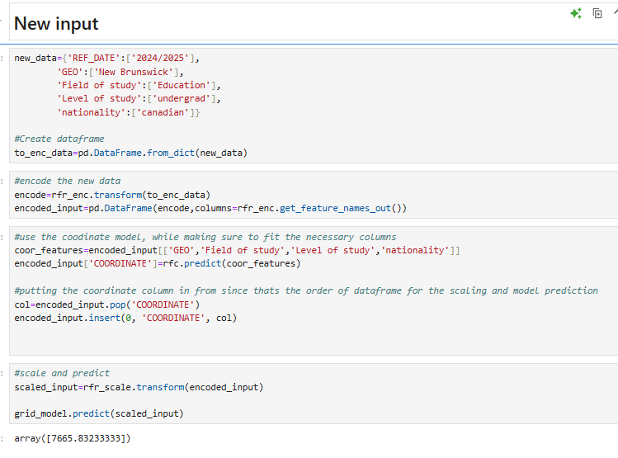
New_inputs

Slide 22
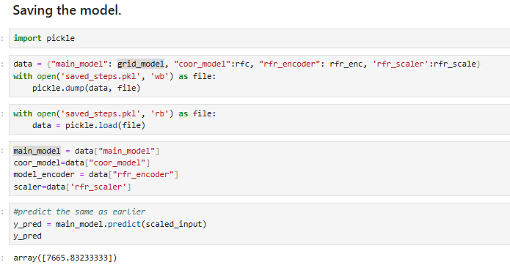
Saving Model

